Slide 1


Italian VIS National System
Innovation Path
Rome, 7 July 2017

Slide 2


Italian VIS National System

Slide 3
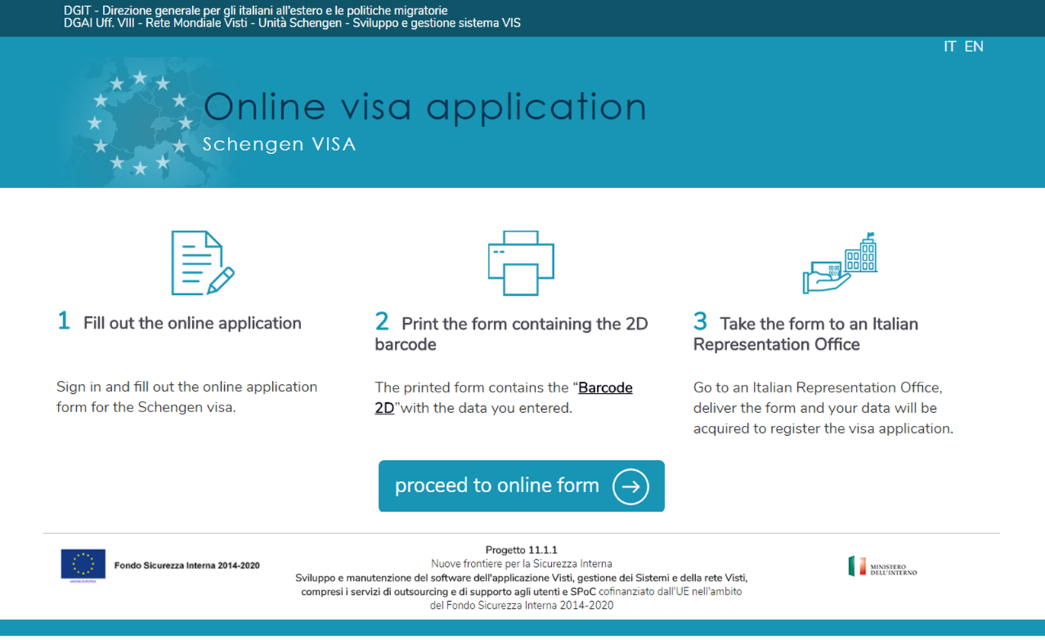
Online application forms
Italian VIS National System
Online application form

Slide 4
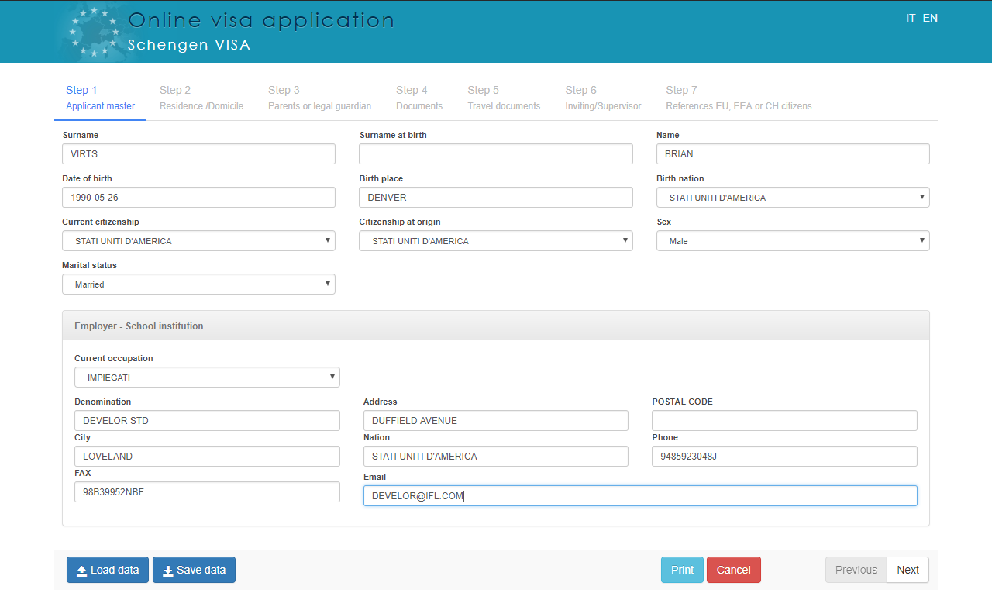
Fill out the online application
Step 1
Applicant Master

Slide 5
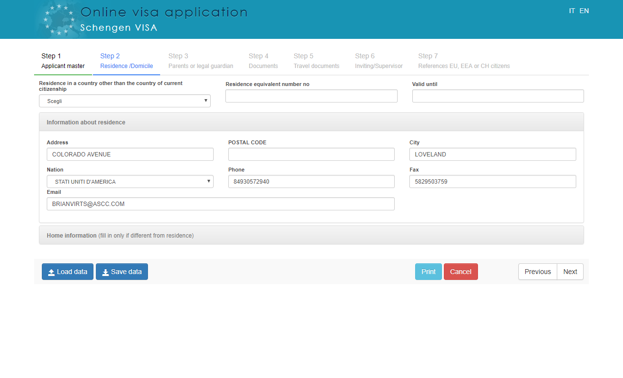
Fill out the online application
Step 2
Residence/
Domicile

Slide 6
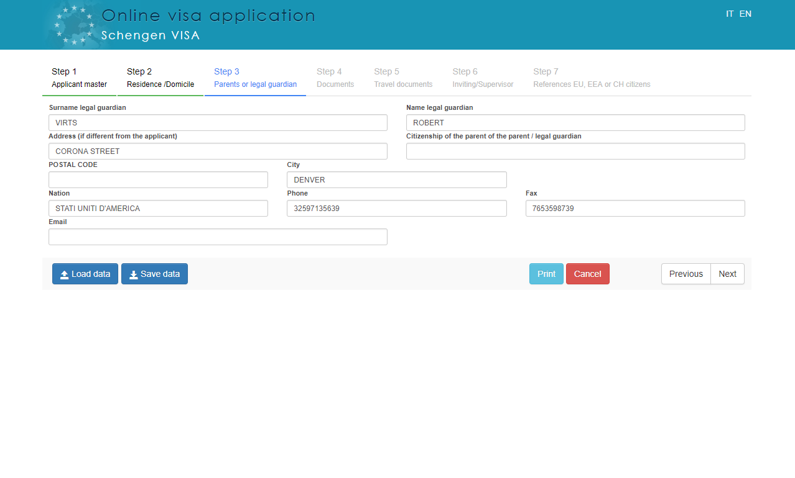
Fill out the online application
Step 3
Parents or legal guardian

Slide 7
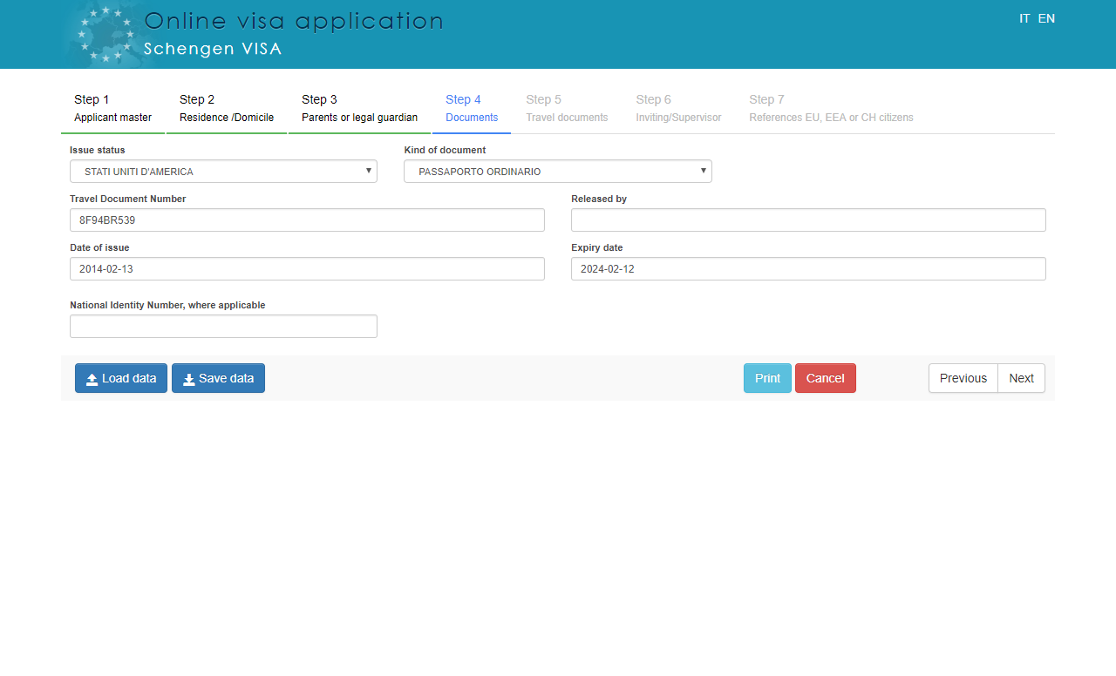
Fill out the online application
Step 4
Documents

Slide 8
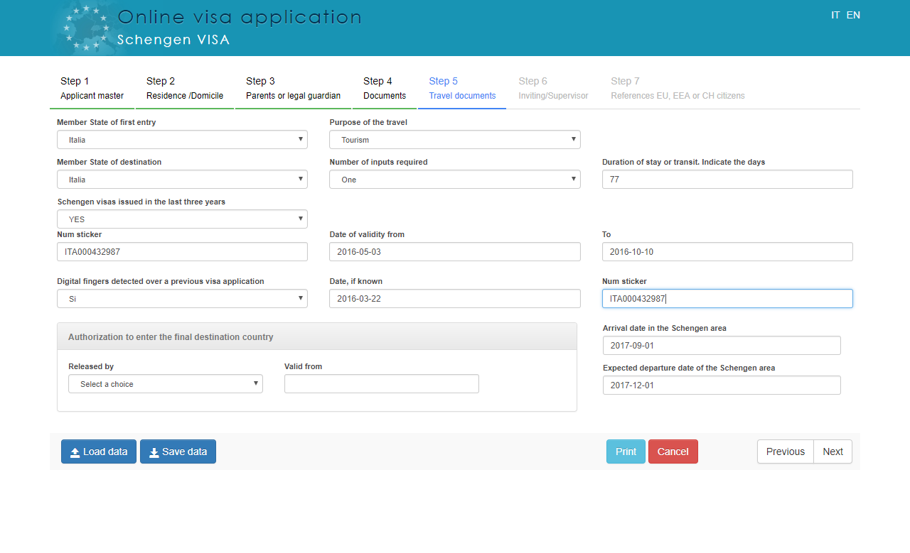
Fill out the online application
Step 5
Travel Documents

Slide 9
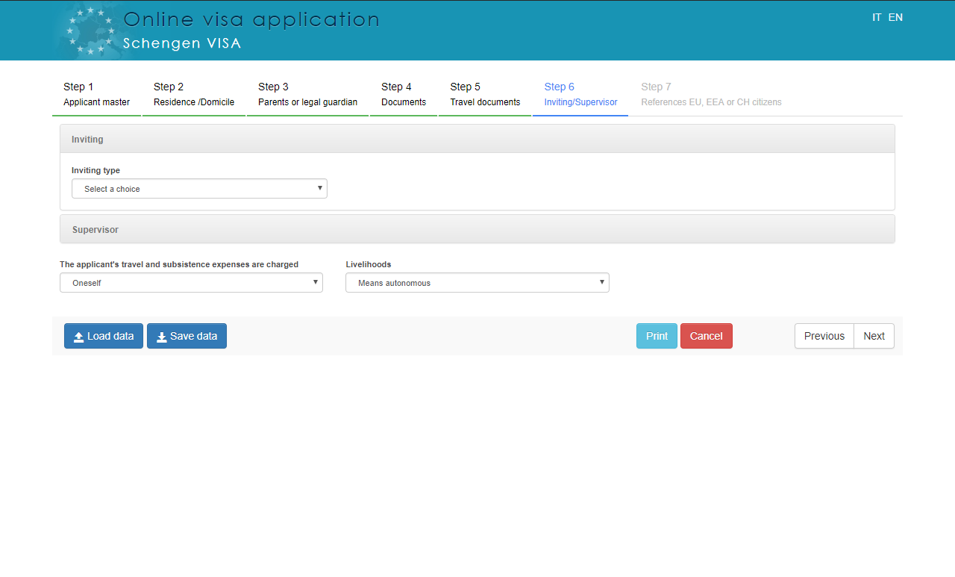
Fill out the online application
Step 6
Inviting/
Supervisor

Slide 10
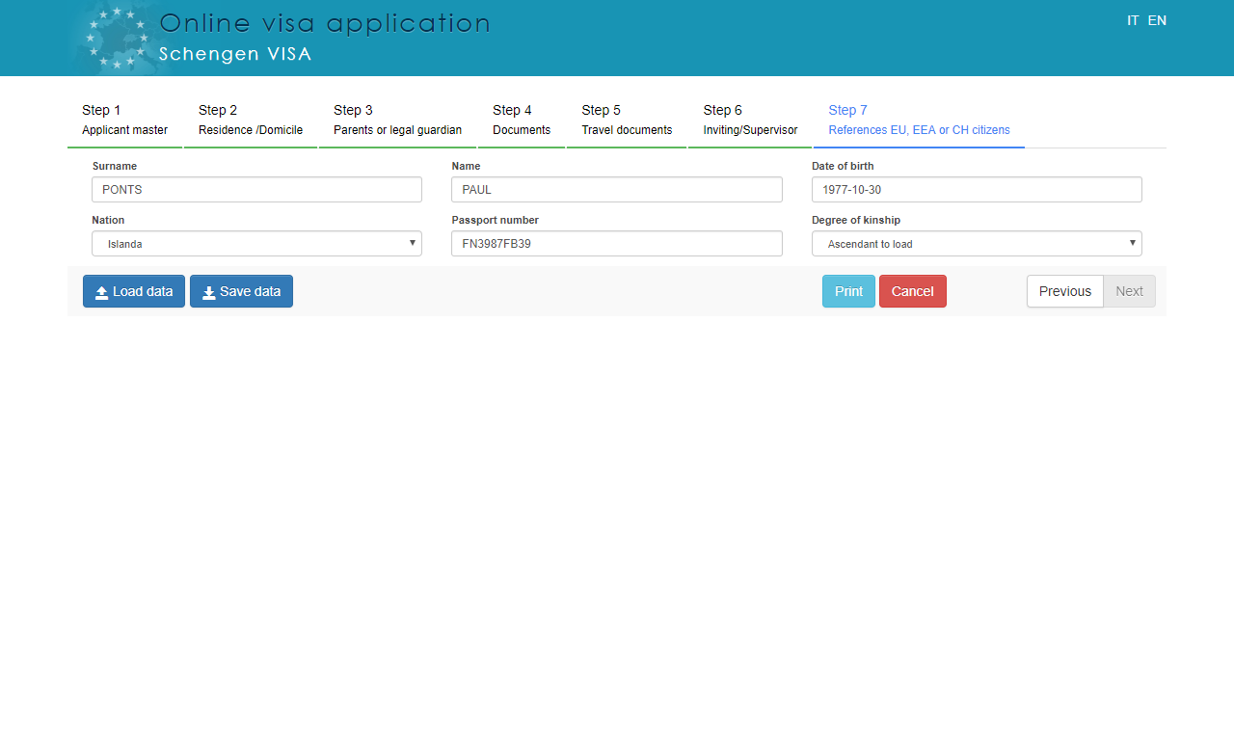
Fill out the online application
Step 7
References EU, EEA OR CH citizens

Slide 11
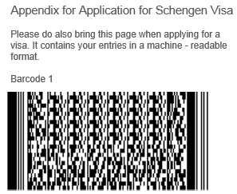
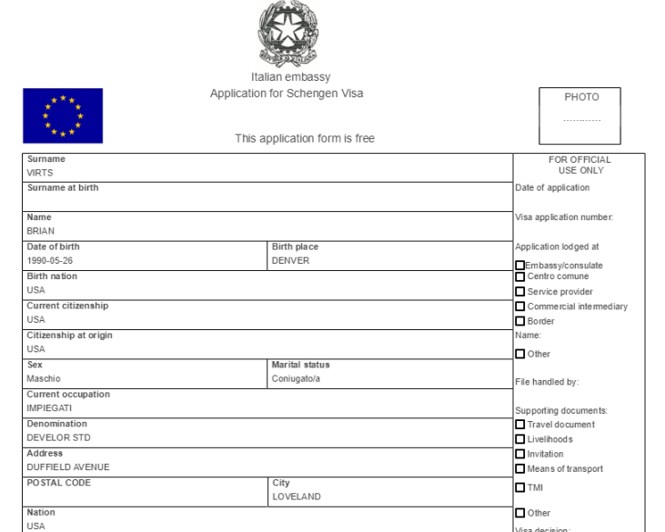
Print the form containing the 2D barcode

Slide 12

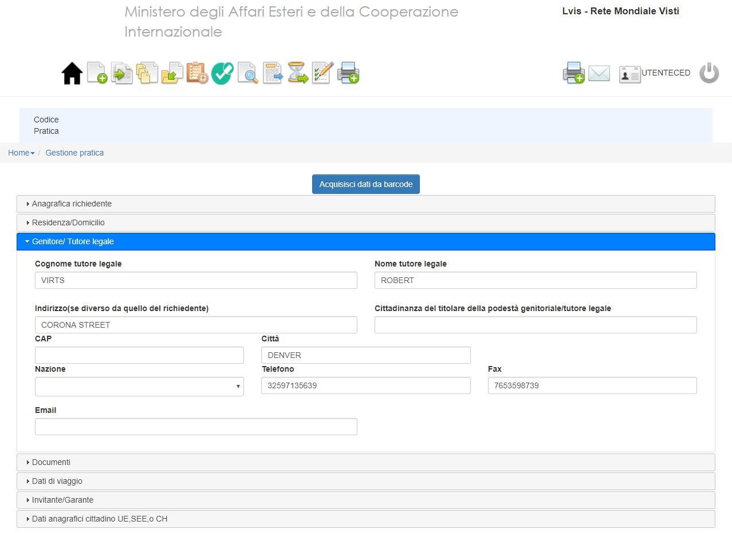

Take the form to an Italian Representation Office
Barcode 1

Slide 13
THANK YOU FOR YOUR ATTENTION
Rome, 7 July 2017

